Slide 1

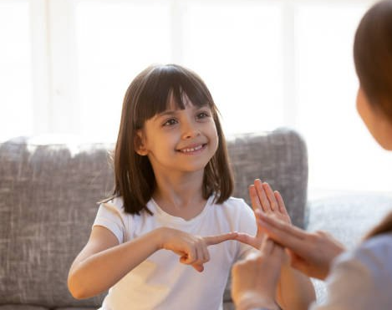
Real Time Sign Language Recognition system for Deaf and Dumb People
GROUP MEMBERS
2010030020 : RISHAL
2010030015 :ANIL KUMAR
2010030288: DILEEP SAI LAVU

Slide 2
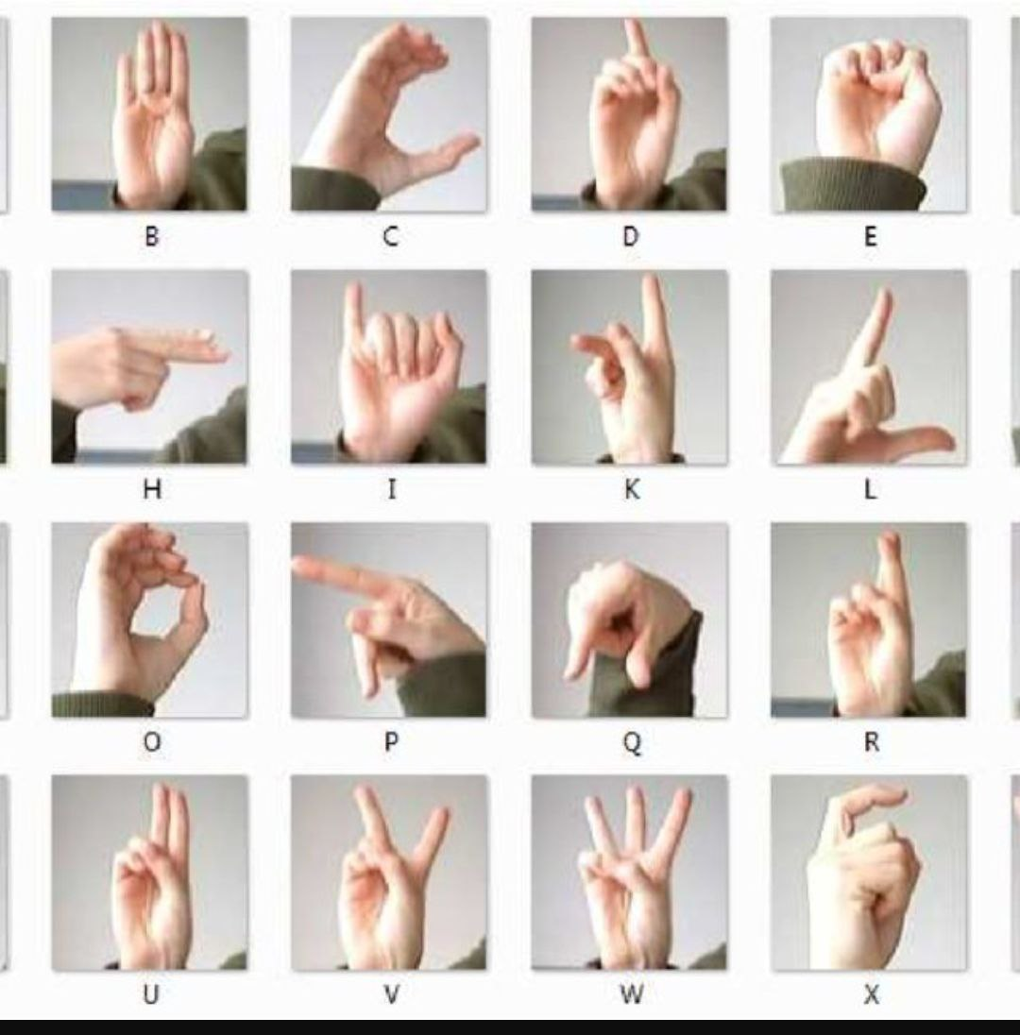
Abstract
Sign languages are a set of predefined languages which use visual-manual modality to convey information. We consider the problem of real time Indian Sign Language (ISL) finger-spelling recognition.
The system takes in a hand gesture as input and returns the corresponding recognized character as output in real time on the monitor screen.

Slide 3
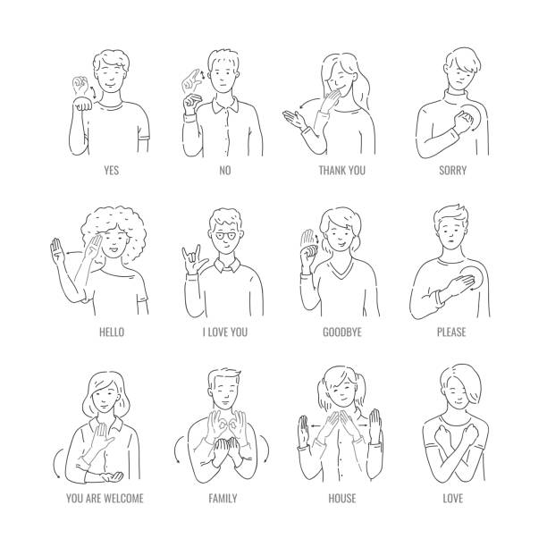
Introduction
Sign languages are developed primarily to aid deaf and dumb people. They use a concurrent and specific combination of hand movements, hand shapes and orientation in order to convey particular information.
One such set of language is the Indian Sign Language (ISL) system which is predominantly used in south Asian countries.
Certain aspect that distinguishes ISL from other sign languages is that ISL devoid of any temporal inflections in its finger spelling chart and also the usage of both the hands.

Slide 4

LITERATURE SURVEY
The paper Real Time Hand Gesture Recognition Paper included the algorithm during which first the video was captured then divided into various frames and therefore the frame with the image was extracted and beyond that frame various features like Difference of Guassian. Scale space Feature Detector and etc were extracted though SIFT which helped in gesture recognition[1].
A method had been developed by P Subha Rajan and Dr G Balakrishnan for recognising gestures for Indian Sign Language where the proposed that each gesture would be recognised through 7 bit orientation and generation process through RIGHT and LEFT scan. The following process required approximately six modules and was a tedious method of recognising signs[3].

Slide 5

Problem statement
Recognize Various Gestures and apply them as input to the computer
Training system for identification of gestures
Convert gestures into Real time language
Input commands to system

Slide 6
STEPS TO SOLVE PROJECT
S.NO | METHODOLOGY
1 | Image Acquisition
2 | Feature Extraction
3 | Gesture Recognition

Slide 7
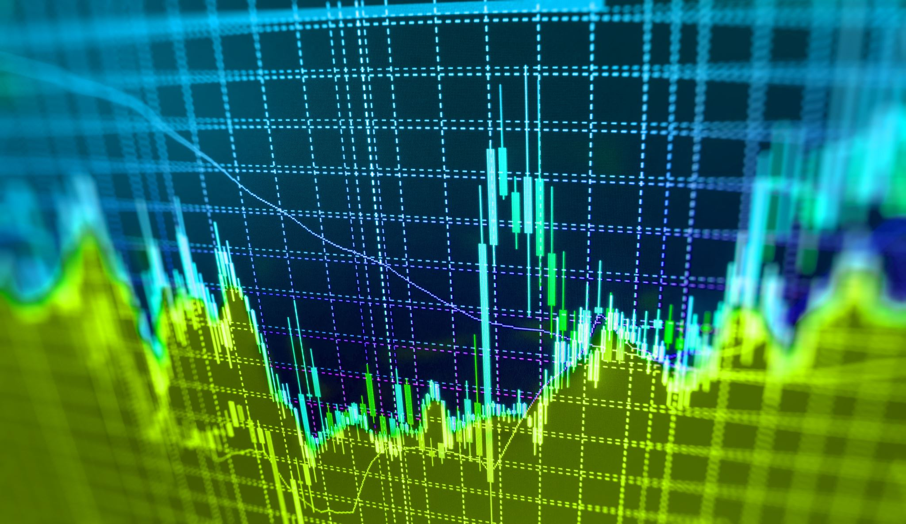
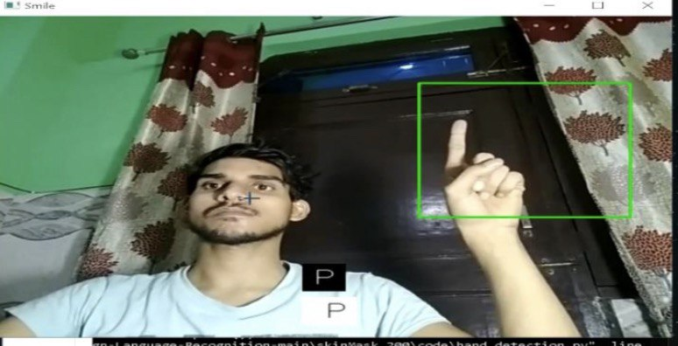
IMAGE ACQUISITION
The first step of Image Acquisition as the name suggests is of acquiring the image during runtime through integrated webcam and while acquiring . The images will be stored in the directory as soon as they are captured and the recently captured image will be acquired and will be compared with the images stored for specific letter in the database using the keras algorithm and the comparison will give the gesture that was done and the translated text for the following gesture. The images will be captured through basic code of opening a webcam through capture video and then capturing the image through frames per second which will be stored in another directory where all the inputs images are stored in another directory and the recent captured image is picked up and the comparison with given set of images are made.

Slide 8
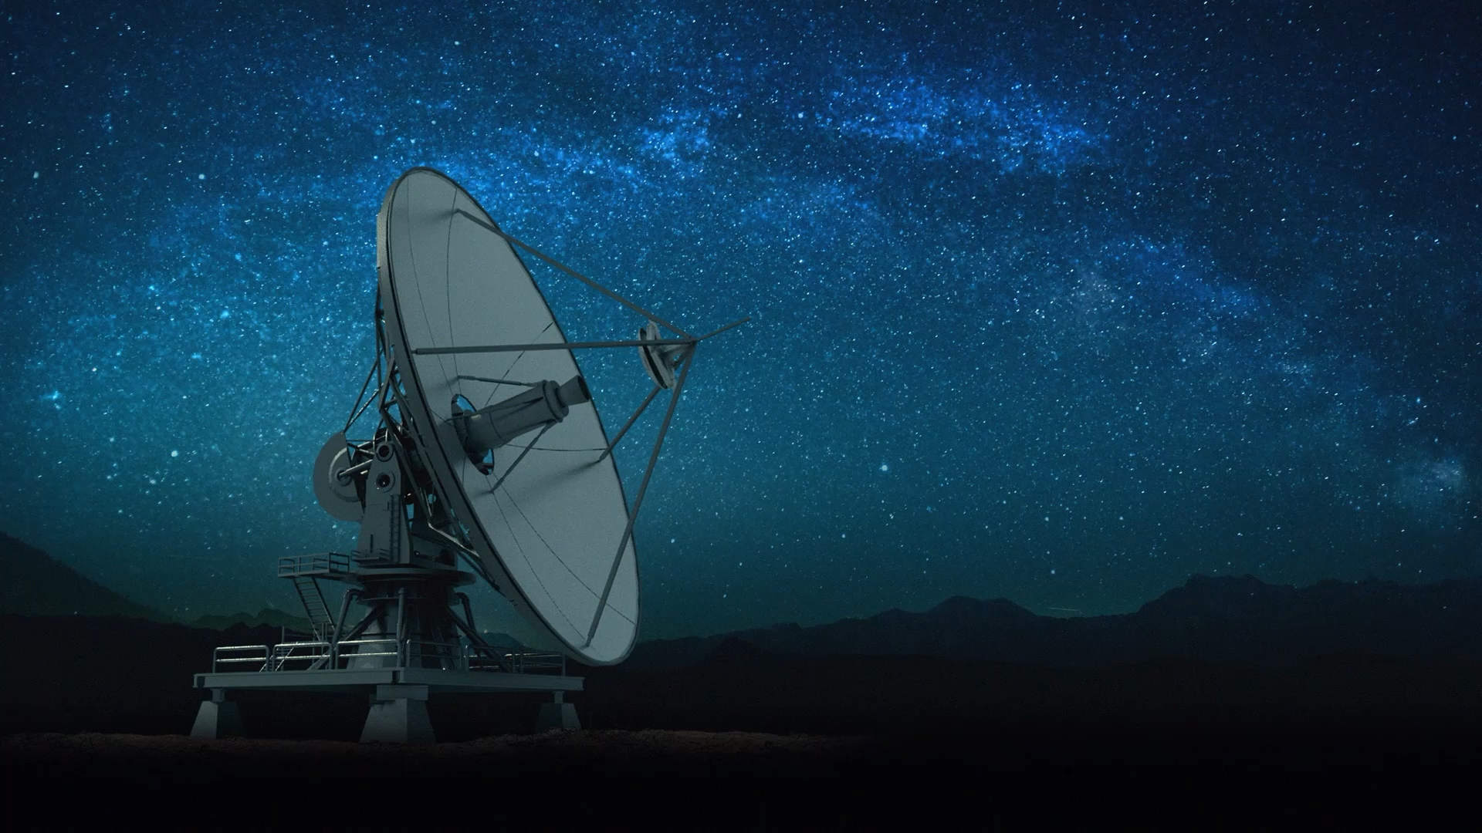
FEATURE EXTRACTION
The model needs to know what input shape it should expect. For this reason, the first layer in a Sequential model (and only the first, because following layers can do automatic shape inference) needs to receive information about its input shape.
There are several possible ways to do this:
pass an input_shape argument to the first layer.
pass instead a batch_input_shape argument, where the batch dimension is included.
two-dimensional inputs, such as images, they are represented by real time language

Slide 9
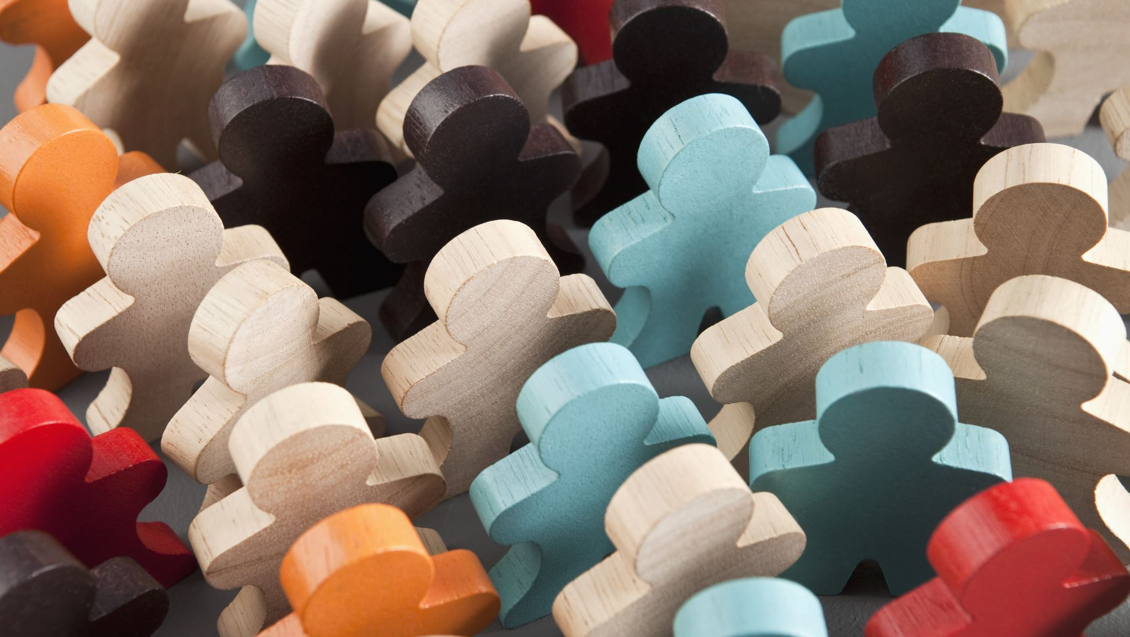
GESTURES RECOGNITION
Finally when the whole process is complete the application will then convert the gesture into its recognized character or alphabet which might be helpful to be understood in layman‟s language. Thefollowing process includes passing out the single dimensional array of 26 character corresponding to alphabets has been passed where the image number stored in database is provided in the array. Supposedly if the image 2.jpg is of „B‟ character inthe database then 2 is passed in the array. Thus the image is picked up from the array and corresponding alphabet is displayed in the interfaceas shown in the given interface below.

Slide 10
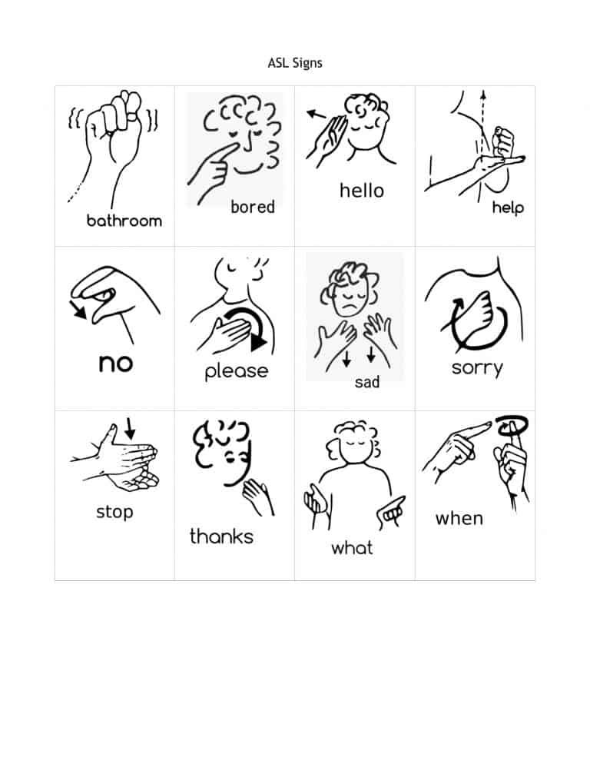
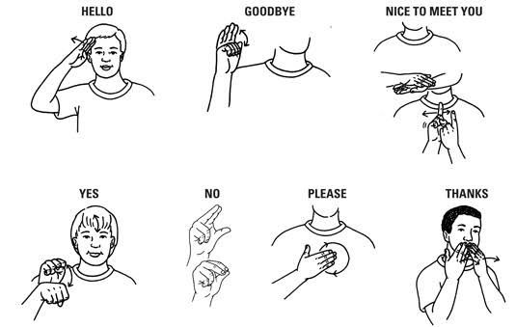
GESTURES OF DIFFERENT SIGNS

Slide 11
REFRENCES
1] Pallavi Gurjal, Kiran Kunnur, “Real Time Hand Gesture Recognition using SIFT”, International Journal for Electronics and Engineering, 2012,pp 19-33.
[2] Ghotkar, Archana S., “Hand Gesture Recognition for Indian Sign Language”, International Conference on Computer Communication and Informatics(ICCCI), 2012, pp 1-4.
[3] https://github.com/yatharth77/Indian-Sign- Language-Gesture-Recognition.
[4] Rajam, P. Subha and Dr G Balakrishnan , "Real Time Indian Sign Language Recognition System to aid Deaf and Dumb people", 13th International Conference

Slide 12
Python Packages
Numpy
Tensorflow
Pickle
Tflearn

Slide 13
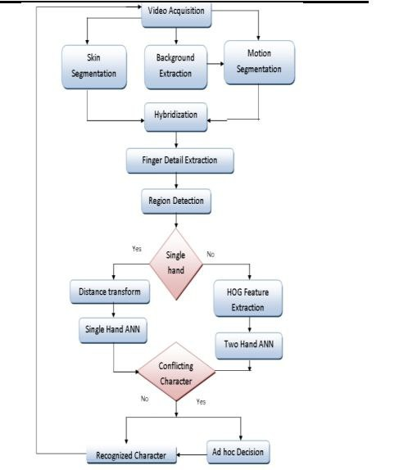
ALGORITHM

Slide 14
Sample Output

Slide 15
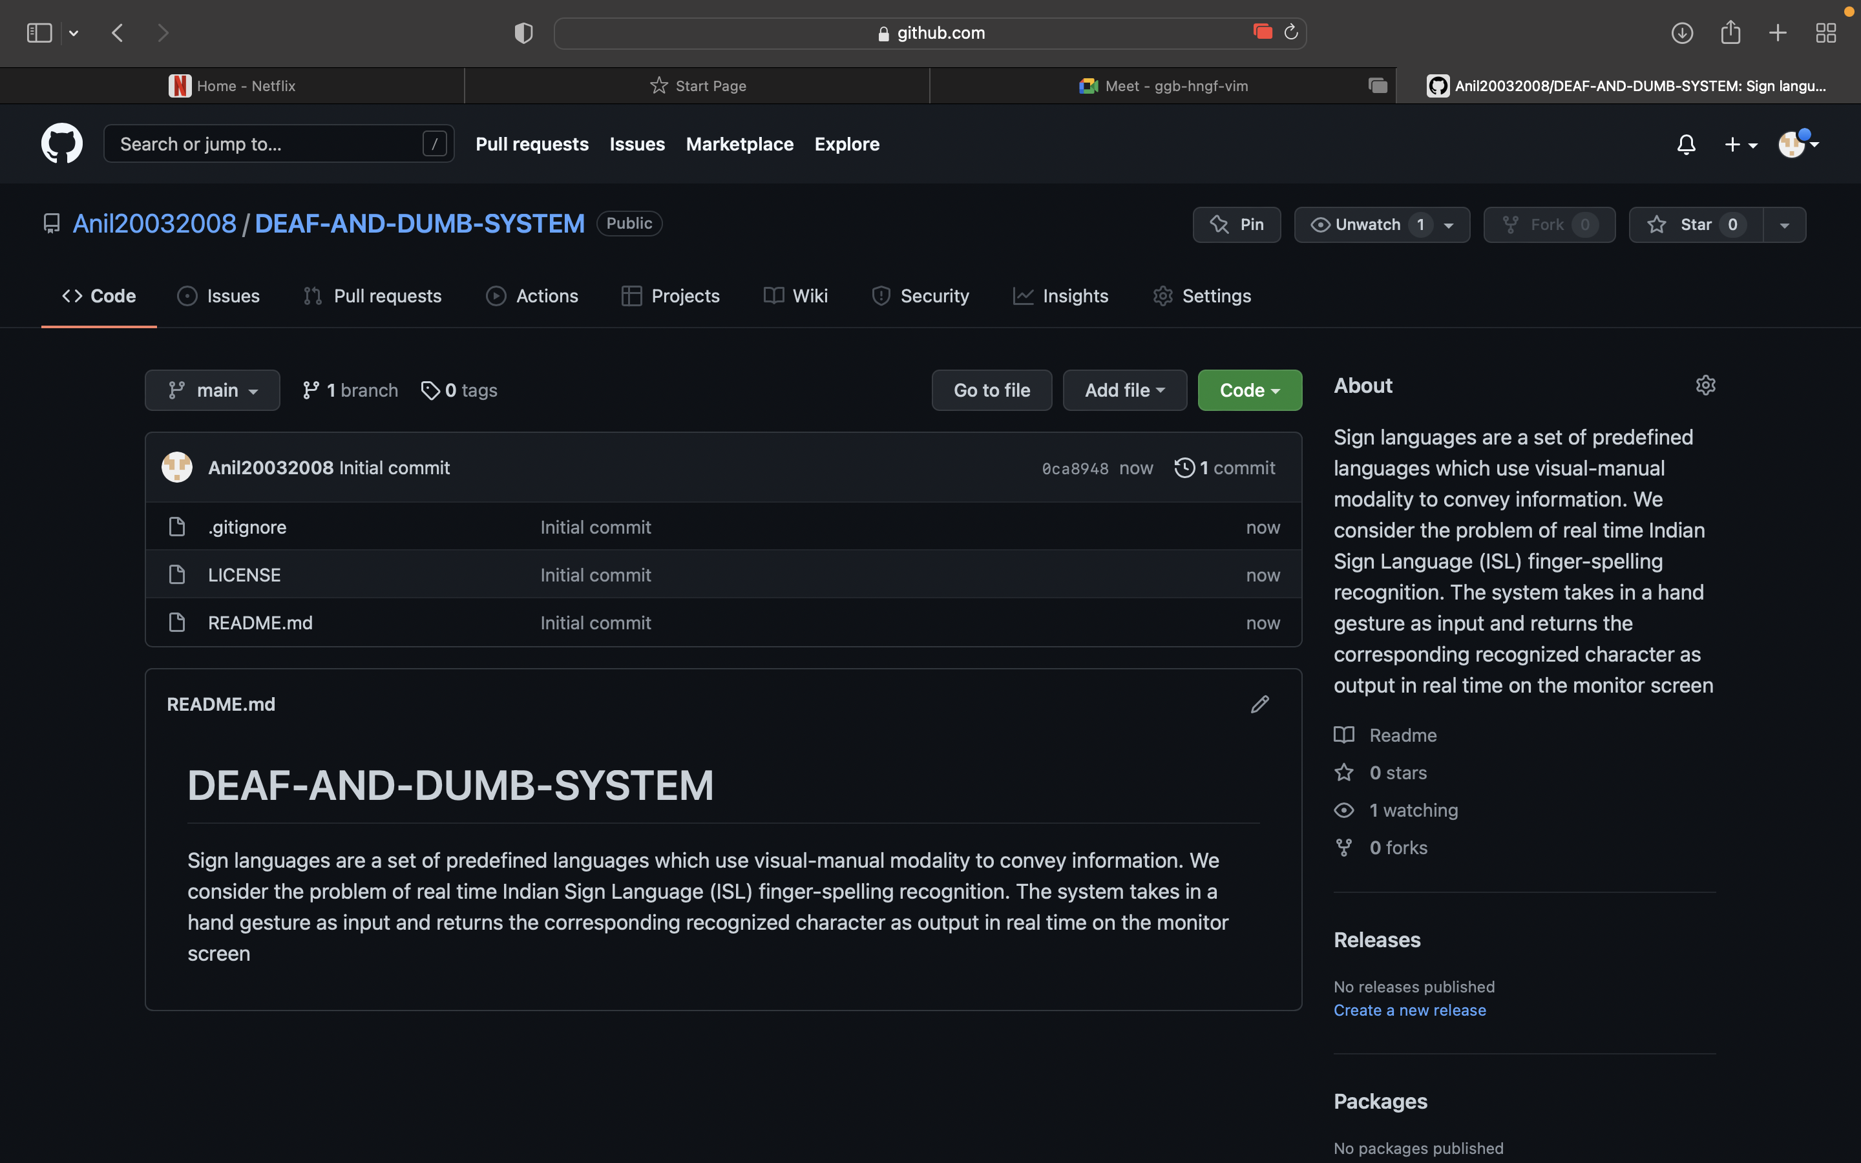
Github Repository
https://github.com/Anil20032008?tab=repositories

Slide 16

Thank you

